Slide 1


Week 3: Feature Engineering and Intro to ML
Building Interpretable AI in Healthcare
Michigan Data Science Team - Winter 2026

Slide 2
Week 3 Agenda
Icebreaker!
01.
02.
Feature Engineering
03.
Intro to Machine Learning
04.
Hands-On Data Science!
Every great project work session starts off with a great icebreaker.
What is feature engineering, and why is it an important step to getting meaningful model output?
What is machine learning, what can we do with it, and what kinds of models can we use?
It’s time to start training those models, engineering those features, and getting closer to our end goal!

Slide 3
01
Fun Icebreaker!!
Get to know us and start to learn about each other with a fun icebreaker!

Slide 4


Icebreaker - Week 3
What would your dream exotic pet be? (No cats, dogs, hamsters, etc.)
Share with the people around you!! :)
Note: that’s actually a Fennec Fox!

Slide 5
02
Feature Engineering
What is feature engineering, and why is it an important step to getting meaningful model output?

Slide 6
What is Feature Engineering?
Feature engineering is the process of turning cleaned (yay for EDA!) input data into interpretable and ready-to-use features in a machine learning model.
The first steps in this are EDA and feature selection, which we covered last week.
Processes Involved in Feature Engineering
Feature Creation - combining existing features into composite measures
Feature Selection - choosing the most relevant features (preprocessing)
Feature Scaling - making sure all features contribute equally to improve model

Slide 7
What does Feature Engineering Do?
Improves Model Accuracy
Choosing the right features helps the model learn better
Better learning, better predictions!
Reduces Overfitting
By using fewer features that hold more importance, we prevent the model from memorizing the data on which we train it
Boosts Interpretability!!
When we choose our features well, we can establish a better understand of why our model makes its predictions

Slide 8
03
Intro to Machine Learning
What is machine learning, what can we do with it, and what kinds of models can we use?

Slide 9
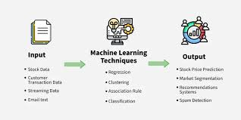
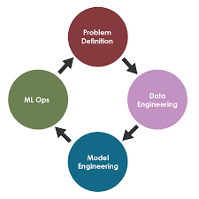
What is Machine Learning?
Machine Learning vs. AI: Machine Learning is a subset of AI that enables computers to learn from data and make predictions, without needing to be explicitly programmed for every specific task.
Main Types of Machine Learning
Supervised Learning: models trained on labeled training data to predict outcomes.
Unsupervised Learning: models that find patterns in unlabeled data.
Reinforcement Learning: models learn through rewards system implemented by developers.
You are here!

Slide 10
The Supervised Machine Learning Process
Collect/Process the Data: In order to do supervised machine learning, we need data that is “labeled,” which means that each observational unit (row) has a known correct target value, which we call the “label.”
Split the Dataset: We need to do a train-test split, where we divide our data into groups we train our model on (typically about 70-80%) and that on which we test it.
Train Your Model: Feed the data into a model of your choice (which we will cover in a second), giving inputs as ‘x’ and your target variable as ‘y.’
Validate and Test: Run the model on your training data and evaluate the accuracy of your output. If there is more to be desired, try adjusting weights or changing model!

Slide 11
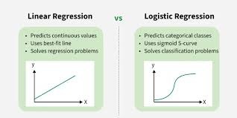
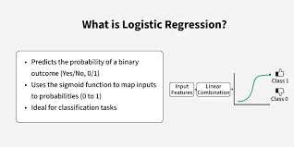
ML Algorithms - Binary Logistic Regression
Binary logistic regression works well in cases where we have a binary target variable
Ex. Stroke/No Stroke, Lung Cancer/None
Considered a classification algorithm, as it attempts to fit points along a sigmoid curve ranging from [0, 1] for our binary target
Models the log-odds (ln(odds of an event)) as a linear combination of independent variables ‘x,’ where a certain threshold (usually 0.5) is used to determine to which category an observation with given log-odds should be assigned.

Slide 12
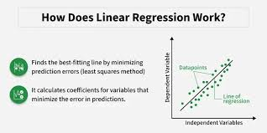
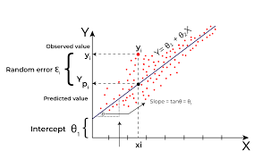
ML Algorithms - (Multiple) Linear Regression
Boils down to a very familiar concept: y = mx + b
If you’re doing multiple linear regression, this formula includes multiple input vars:
y = b + m₁x₁ + m₂x₂ + … + m_{n}x_{n}
Plots a “best fit” line through the data that minimizes squared errors of observed vs. expected values.
Always fitted linearly
Goal: find a best fit line that most accurately models the spread of data points for the target.
Key Assumptions
Assumes linear relationship between x and y
(For multiple) No multicollinearity

Slide 13
04
References
Here are a handful of useful guides to high-utility functions, Git demos, and Colab explanations!

Slide 14
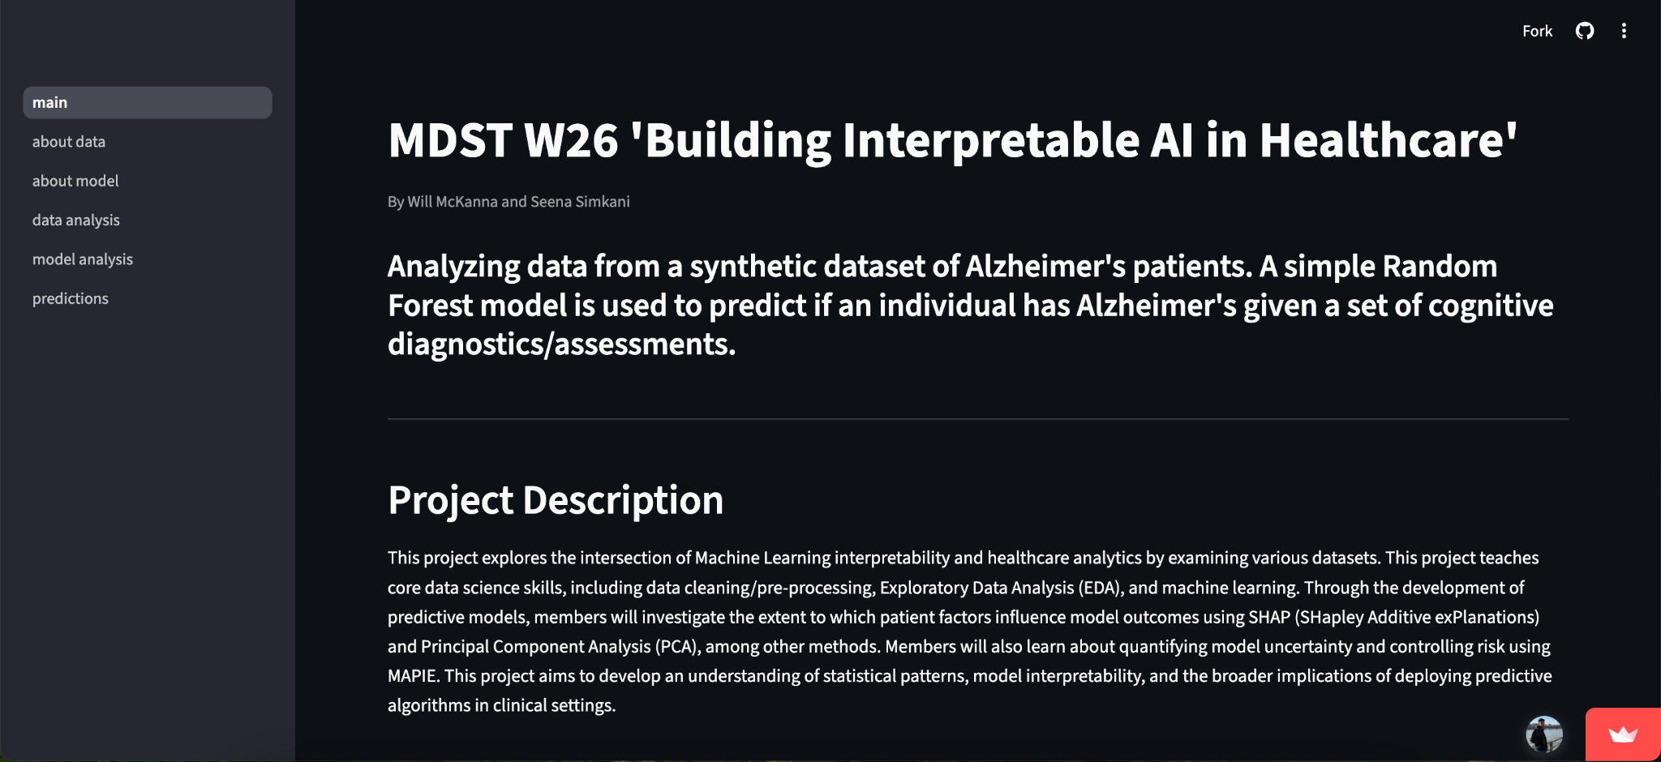
Our Demo! (for reference)
Link: https://mdst-ai-in-healthcare.streamlit.app/

Slide 15





Project Timeline
Week 1 (01/25): Icebreaker/EDA intro, choosing a good dataset
Week 5 (02/22): Conformal Predictions, Risk Control, and Multi-Class Calibration
Week 2 (02/01): Data Visualization, Further EDA
NO MEETING 03/01 OR 03/08 – SPRING BREAK
Week 6 (03/15): SHAP Values and Feature Importance Interpretation
Week 3 (02/08): Feature Engineering and Intro to Machine Learning
Week 7 (03/22): Intro to Streamlit and Project Work Time
Week 4 (02/15): Machine Learning and Model Optimization
Weeks 8 + 9 (03/29 + 04/05): Final Project work time + Data Science Night prep!

Slide 16
Important Functions to Know (pt. 1)
Syntax | Description
import pandas as pd | Import the pandas library, using the alias pd for convenience
import numpy as np | Import the NumPy library, using alias np for numerical operations
import seaborn as sns | Import Seaborn for statistical data visualization
df = pd.read_csv(‘file.csv’) | Load a CSV file into a pandas DataFrame for data manipulation
df.head() | Returns the first 5 rows of the DataFrame, useful for quickly inspecting data
df.info() | Provides a concise summary of the DataFrame, including data types and non-null values

Slide 17
Important Functions to Know (pt. 2)
Syntax | Description
df.describe() | Generates descriptive statistics of numerical columns (mean, median, quartiles, etc.)
df[‘column_name’] | Access a specific column in the DataFrame, works like a key in a dictionary
df.drop(columns=[‘col’...]) | Drops specified columns from the DataFrame,use inplace=True to modify the original DataFrame
df.index | Returns the index labels of the DataFrame
df.isnull() | returns a DataFrame of boolean values, where each entry indicates whether the corresponding value in df is NaN (missing)

Slide 18
Important Functions to Know (pt. 3)
Syntax | Description
df[‘column’].value_counts() | Returns the count of unique values in a specific column
df[‘column’].mean() | Returns the mean value of a numerical column
df.corr() | Computes correlation for numerical columns to understand relationships
df.columns | Lists all column names in the DataFrame, useful for renaming or viewing dataset structure
df.shape | Returns # of rows and columns

Slide 19
Important Functions to Know (pt. 4)
Syntax | Description
df.rename(columns={'old': 'new'}, inplace=True) | Renames specific columns to new names
df.groupby(‘category’)[‘value’] | Groups the DataFrame using a specified column to perform aggregate functions (e.g., .sum(), .mean())
df[‘new_column’] = df[‘column’].apply(function) | Applies a function to each element or column/row
df.shape | Returns a tuple representing the dimensions (rows, columns) of the DataFrame
df.dropna() | Removes rows or columns containing missing values

Slide 20
Important Functions to Know (pt. 5)
Syntax | Description
df.to_numpy() | Converts Pandas DataFrame into a NumPy array
np.shape | Returns a tuple representing the dimensions (rows, columns) of the array (similar to df.shape)
np.reshape() | Reshapes an original numpy array to the specified dimensions (rows, columns)
np.array() | Creates an N-dimensional array (ndarray) which is more memory efficient than standard python lists
np.unique() | Returns the unique elements in a NumPy array (also returns the counts of each element given the keyword argument, return_counts=True)

Slide 21
Important Functions to Know (pt. 6)
Syntax | Description
pd.cut() | Turns continuous numerical data into categorical data
pd.get_dummies(drop_first = True) | Dummy encodes categorical data (used with drop_first argument)
OrdinalEncoder() | Function for encoding categorical information that has an order
train_test_split(X, y, test_size=0.2, random_state=42) | Splits data into a training set and a testing set. The test set size can be changed
LinearRegression() | Used for initializing a linear regression model
LogisticRegression() | Used for initializing a logistic regression model

Slide 22
Important Functions to Know (pt. 7)
Syntax | Description
StandardScaler() | Turns continuous numerical data into categorical data
model.fit(X_train, y_train) | Fits a model to the training data
model.predict(X_test) | Uses the test data to make predictions
.coef | Attribute for getting the models coefficients (for linear and logistic regression)
mean_squared_error() | Calculates the average squared distance between the predicted and actual data points
mean_absolute _error() | Calculates the average distance between the predicted and actual values

Slide 23
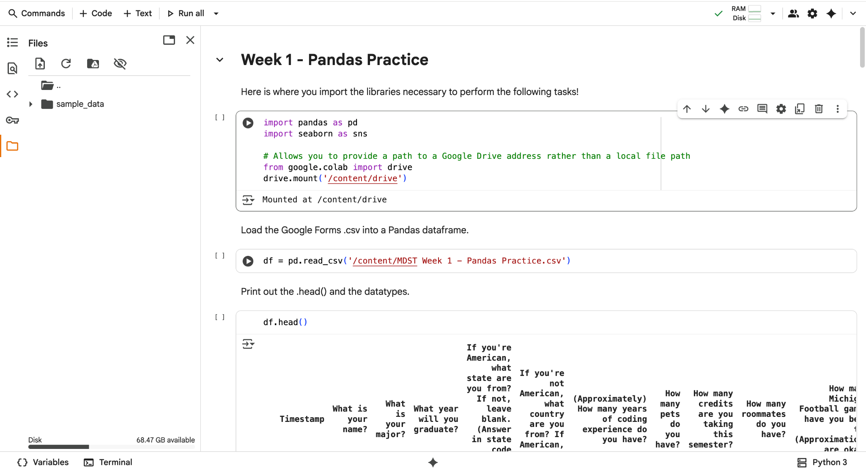
How to Upload Files into Colab
Click on the folder in the sidebar

Slide 24
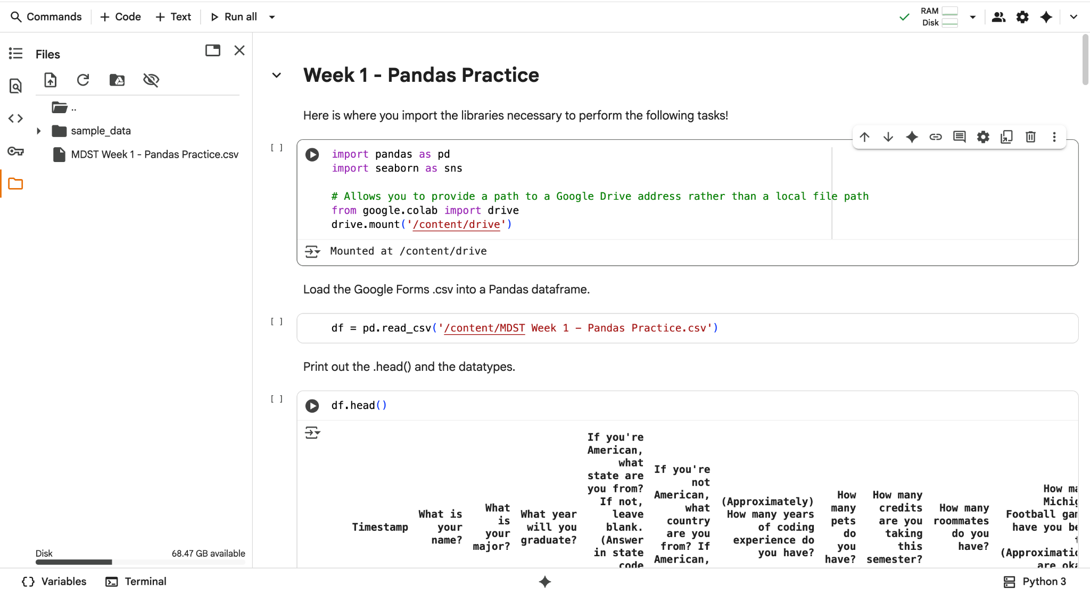
How to Upload Files into Colab
Click the upload button and select the file you want to upload

Slide 25
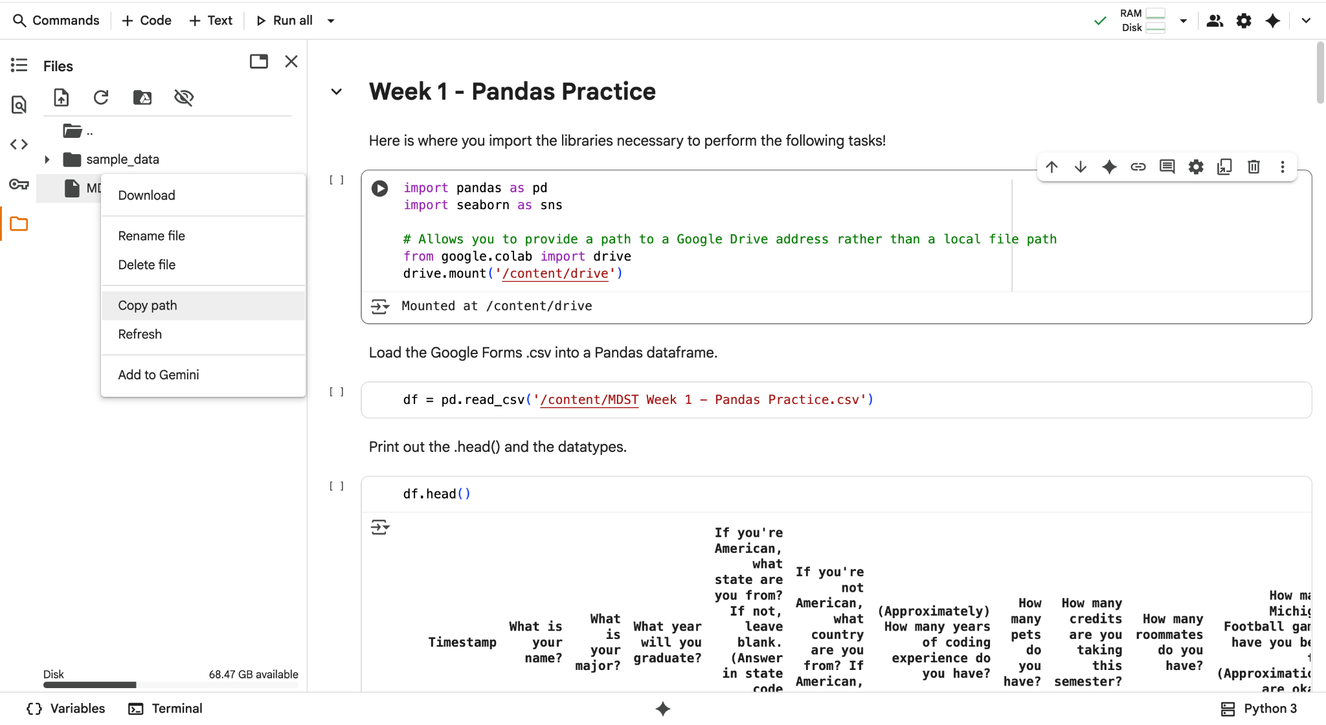
How to Upload Files into Colab
Click the three dots and copy the path. Put this in your read function

Slide 26
How to Mount Your Google Drive
from google.colab import drive
drive.mount('/content/drive')
pd.read_csv(‘/content/drive/MyDrive/[FILE NAME]’)
**NOTE: If you saved your dataset in a folder (not just loose in your MyDrive folder), you will need to add further code to the file path before the file name in the final line. For example, if I saved my data called “alzheimers.csv” in a folder called “MDST-W26,” my read_csv statement would read:
pd.read_csv(‘/content/drive/MyDrive/MDST-W26/alzheimers.csv’)

Slide 27

How to Create a GitHub Repository (yay for version control!)
Navigate to GitHub, click your profile picture, and select “Repositories.” Then, click the green “New” button next to the “Language” dropdown menu

Slide 28
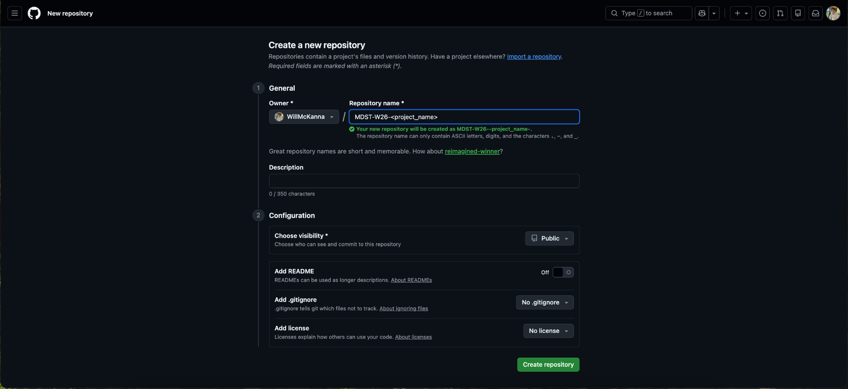
How to Create a GitHub Repository (yay for version control!)
2. Name your repository something memorable, then click “Create Repository”

Slide 29

How to Create a GitHub Repository (yay for version control!)
3. Then, populate your repo either with your files, OR click “creating a new file”

Slide 30
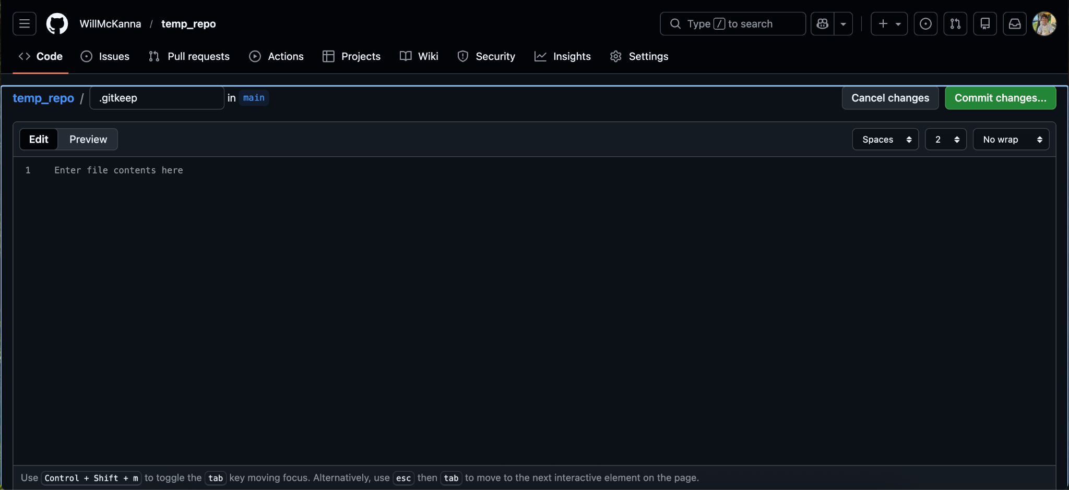
How to Create a GitHub Repository (yay for version control!)
3(b). If you click “create a new file,” entitle it “.gitkeep” and click “Commit changes”

Slide 31
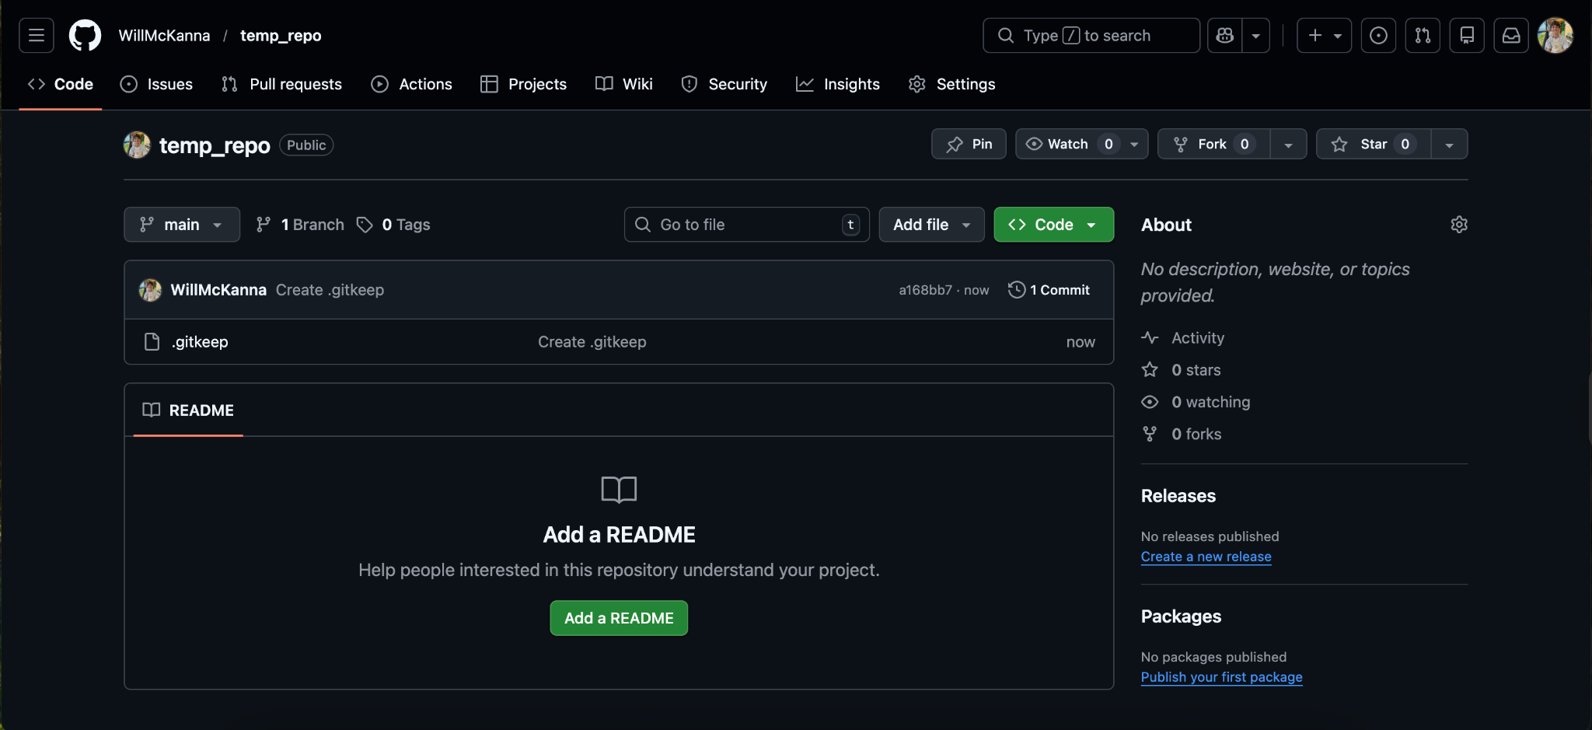
How to Create a GitHub Repository (yay for version control!)
4. Your repo is made! Continue adding to it by clicking the “Add file” dropdown menu

